Slide 1

o c t a n e :
Project
The Robo_Vac
Powered by :
Team Iconic
Ahsanullah University of Science & Technology,
Dhaka – 1208
Team Members:
Miftahul Sheikh
Nafisa Tasnim Neha
Misbahul Sheikh
Naushin Mamun

Slide 2

Contents:
Introduction
Features
Softwares
Components
Circuit Diagram
Pin Connections
Goal of The Project

Slide 3
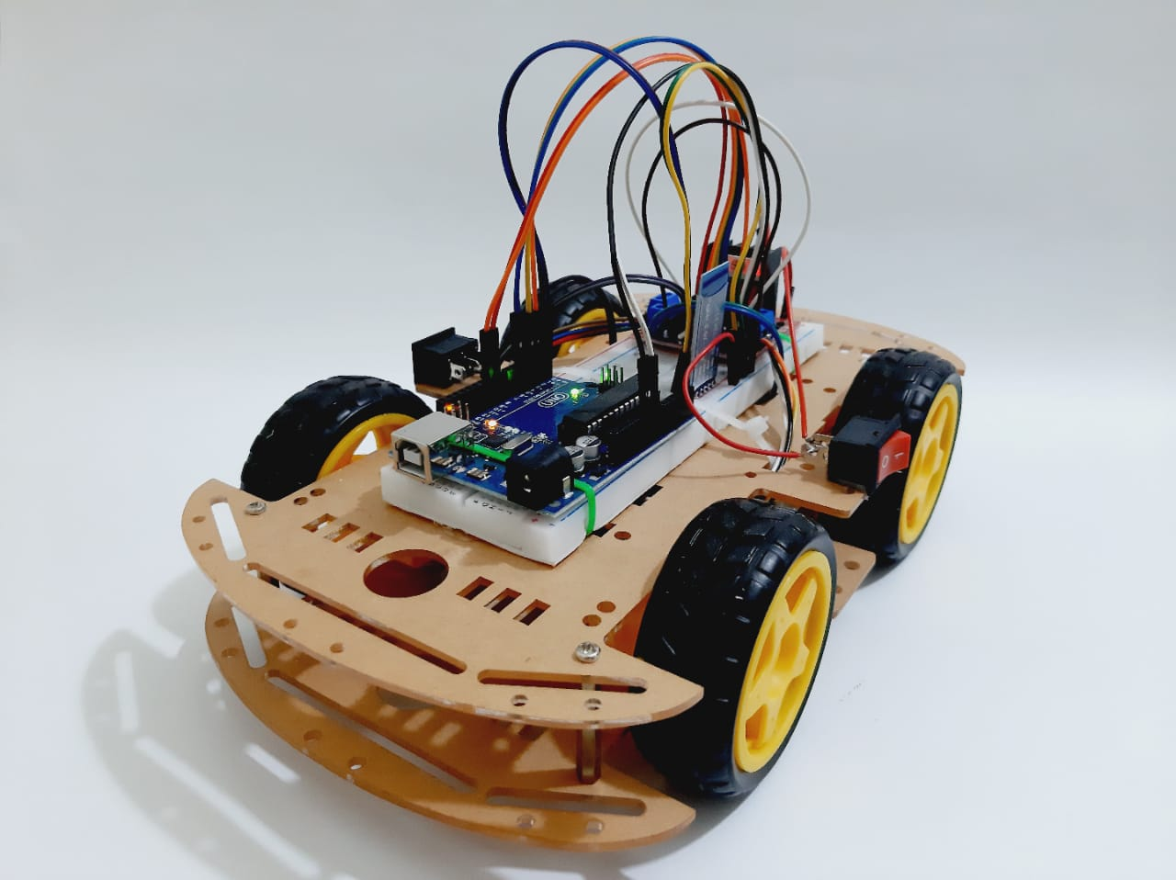
Introduction
Android controlled octane Robo_Vac vaccum cleaner car.
Can clean dust, dirt & paper pieces from floors.
Doesn’t have any sensors.
Machine can be controlled by any android mobile phone .
User can perform actions like moving forward, backward, moving left and right by the means of command using his-her mobile phone app.

Slide 4
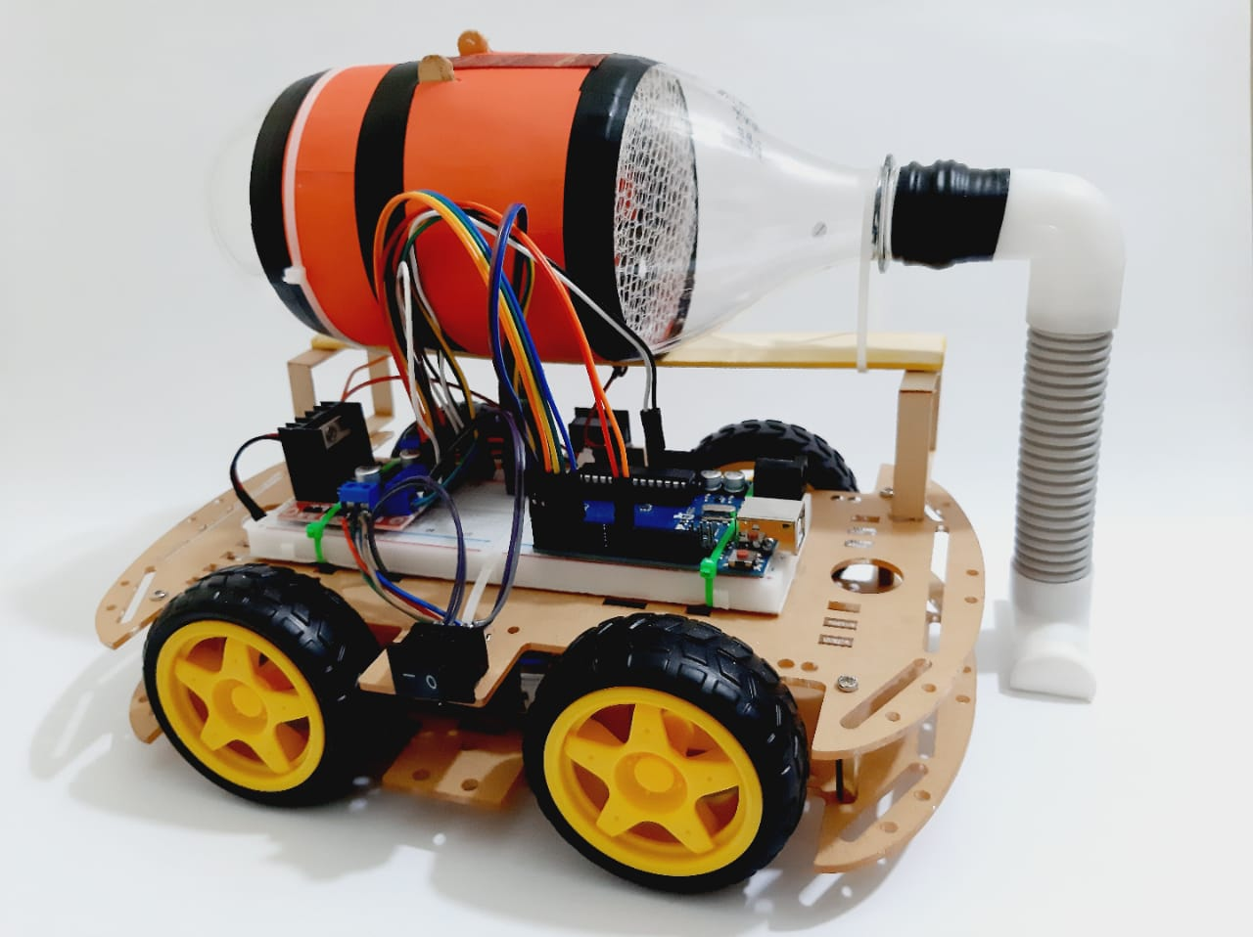
Features
Our Robo_Vac can clean dust, dirt & paper pieces from floors.
Can easily control the car by using a simple mobile app.
Contains 4 motors for 4 wheels, an Arduino UNO, a motor driver, a Bluetooth module, and some extra components.
Easy to control the speed limit with a simple touch.
Can use this car for different purposes by simply modifying the code in Arduino.
Future up-gradation is possible.
Octane
Robo_Vac

Slide 5


Softwares
We have used two software to develop this projects
Arduino IDE
Bluetooth RC Controller
Arduino IDE
Mobile App (Bluetooth RC Controller)

Slide 6
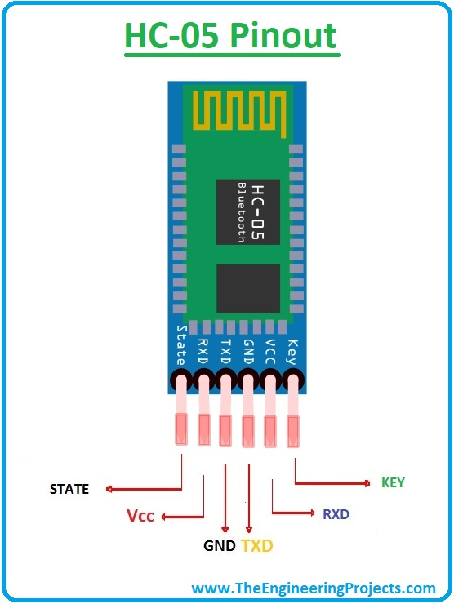
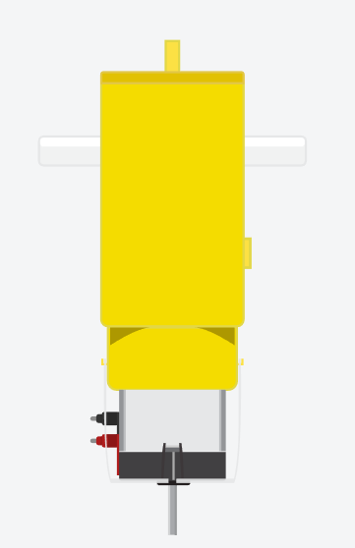
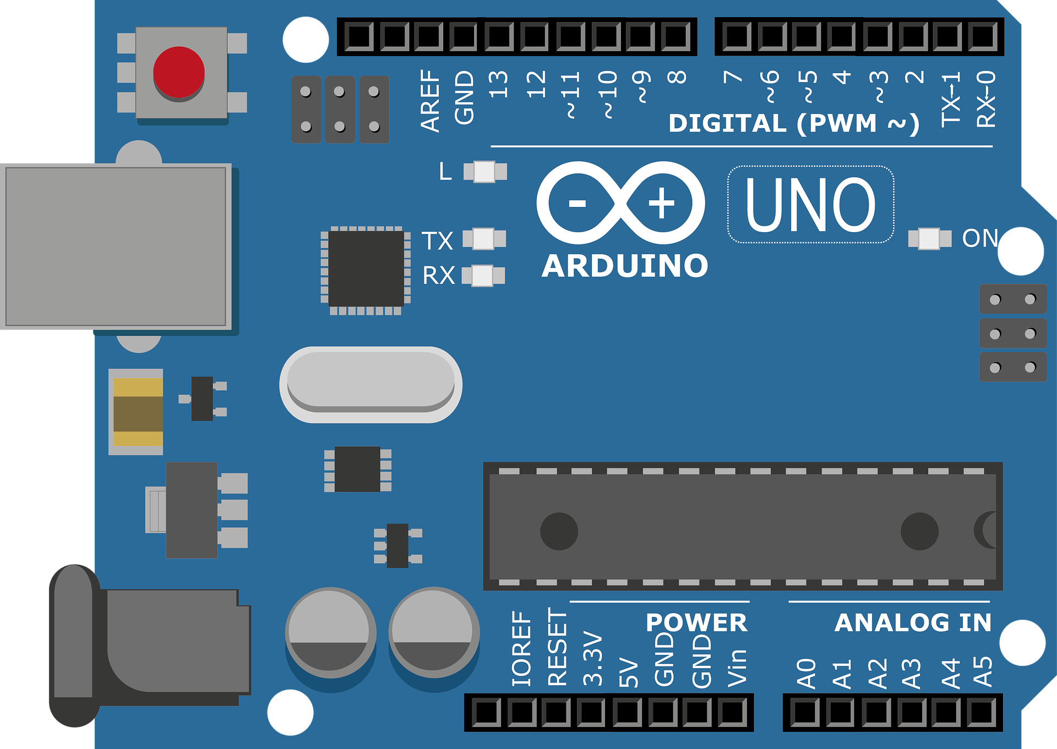
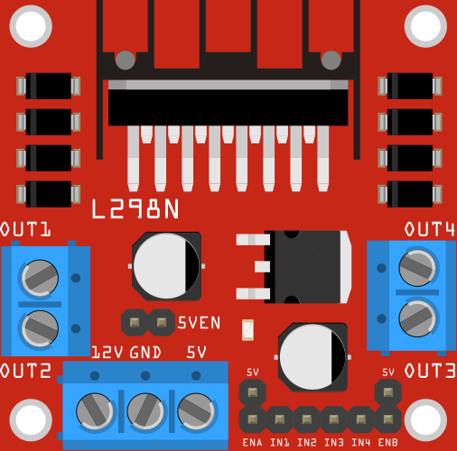
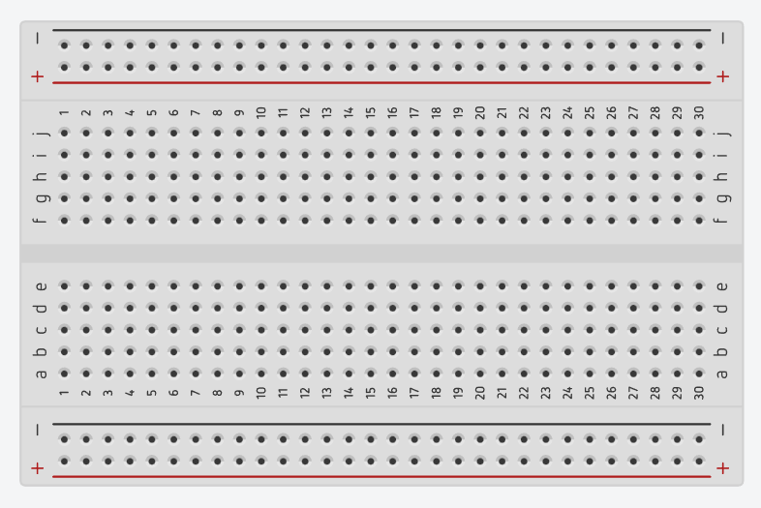
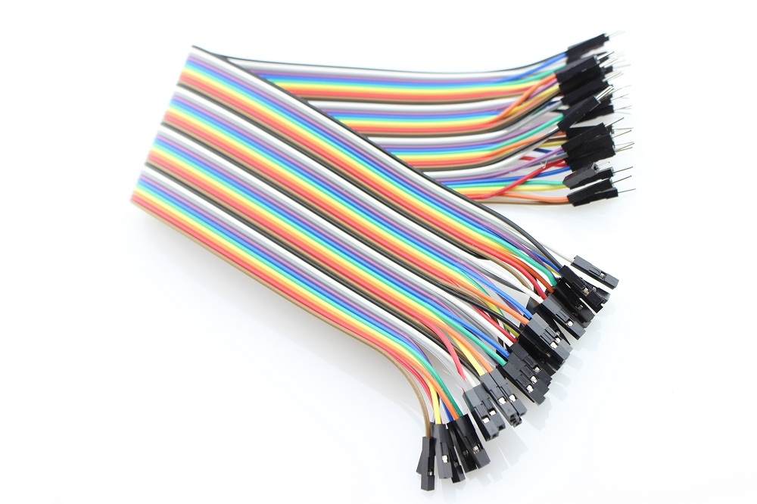
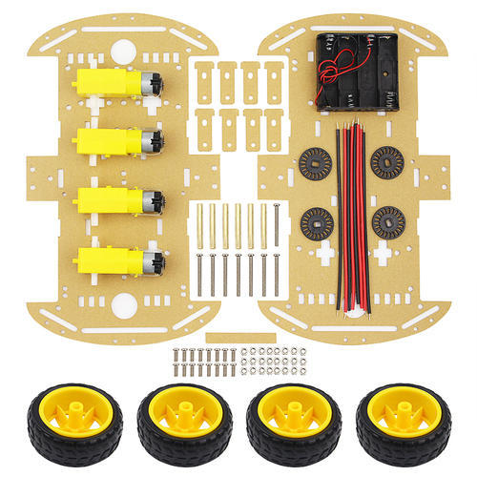
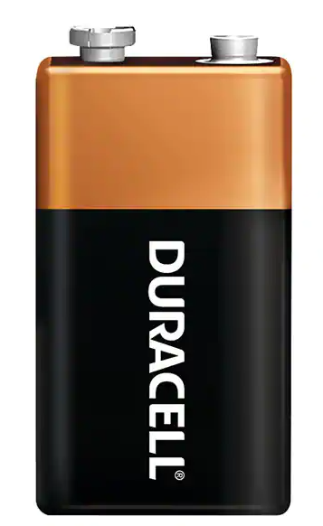

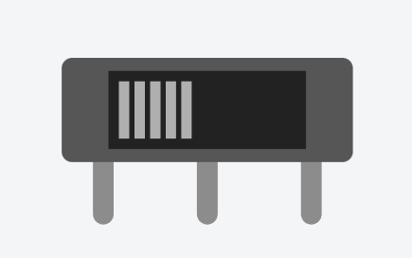
Components
Arduino UNO
Motor Driver
Bluetooth Module
Motor
Bread-board
Wires
Chassis
Li-Po Battery
& 9v Battery
Switch

Slide 7
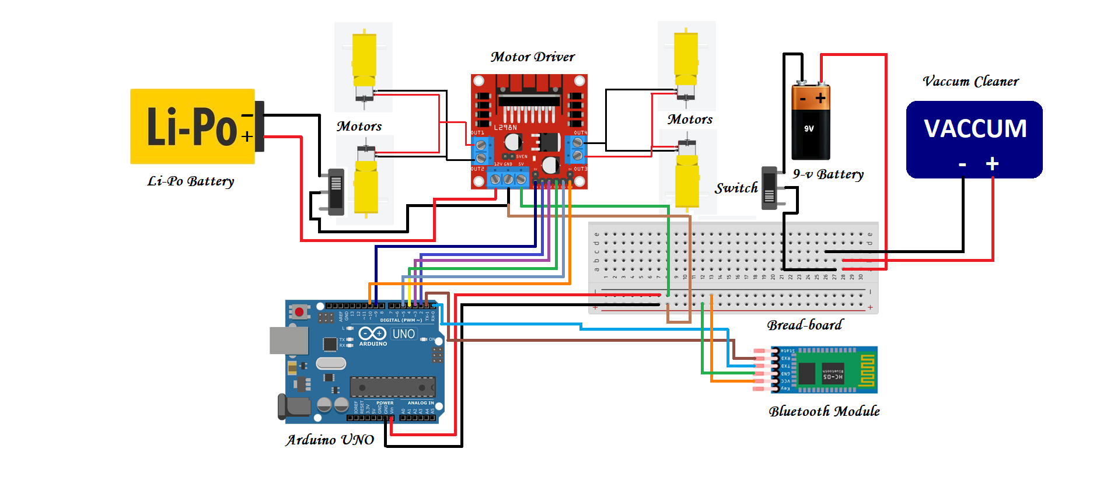
Circuit Diagram

Slide 8
Pin Connections
Motor Driver | Arduino UNO
EN-A | Pin - 9
In1 | Pin - 2
In2 | Pin - 3
In3 | Pin - 4
In4 | Pin - 5
EN-B | Pin - 10
Bluetooth Module | Arduino
TXD | RXD
RXD | TXD
VCC | 5 V
GND | GND

Slide 9
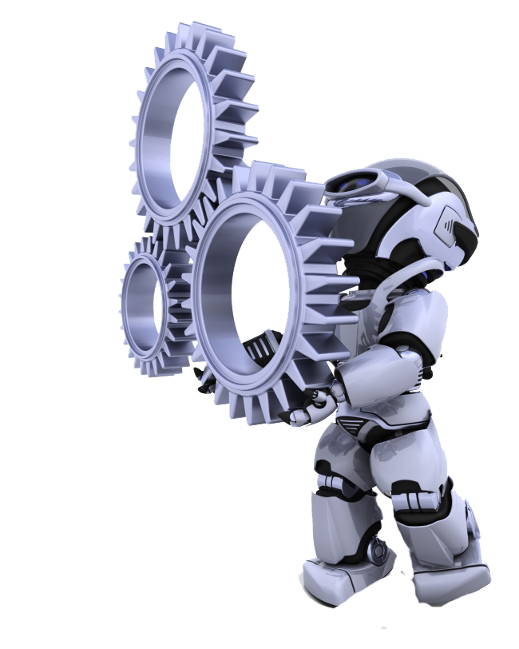
Goal of The Project
The main goal of this project is to solve our daily life problems.
This project can make our life more easier then before, in cleaning.
To inspire the young generation about electrical devices like Arduino UNO, different types of sensors, mechanics and robotics is also our goal.

Slide 10
Thank you…

